Slide 1
UNIT-II
OPTICAL SOURCES, Amplifiers and Transmitter

Slide 2
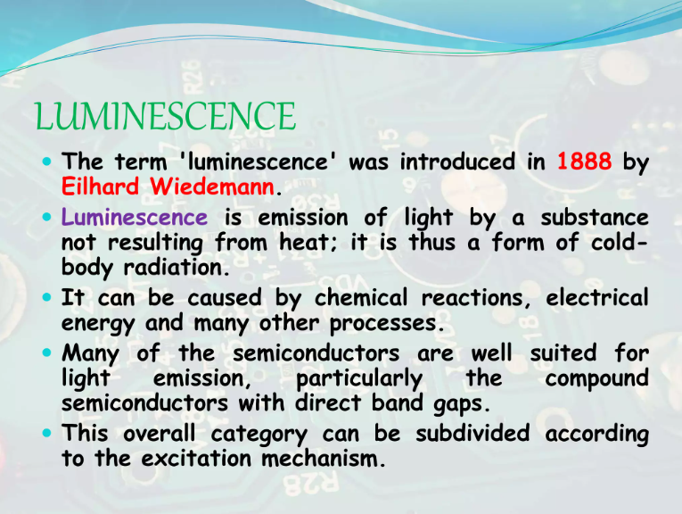

Slide 3


Slide 4
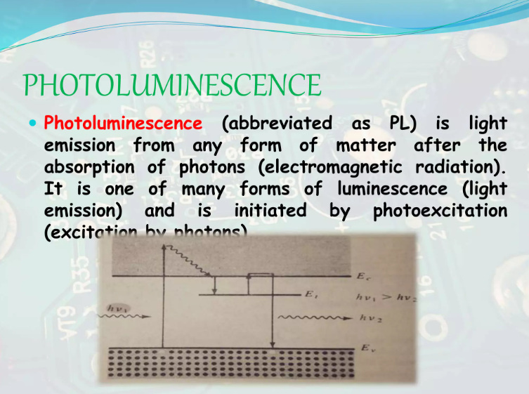

Slide 5
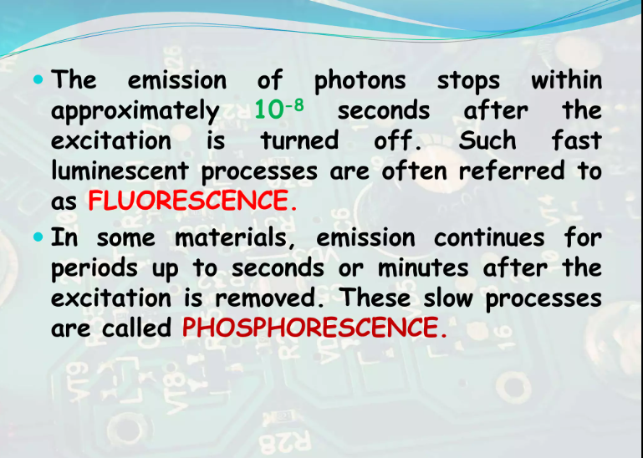

Slide 6
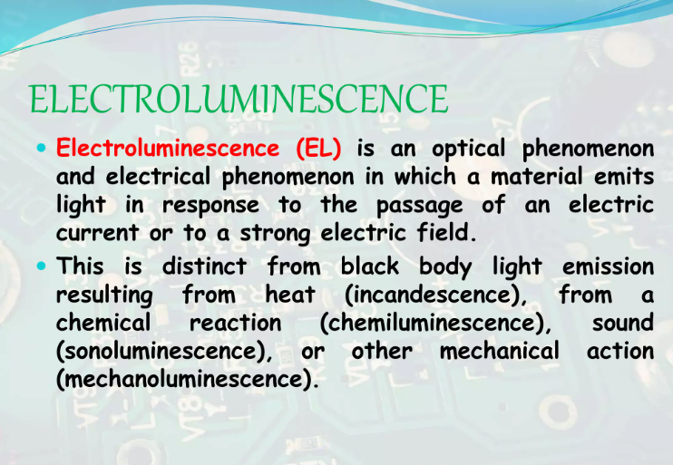

Slide 7
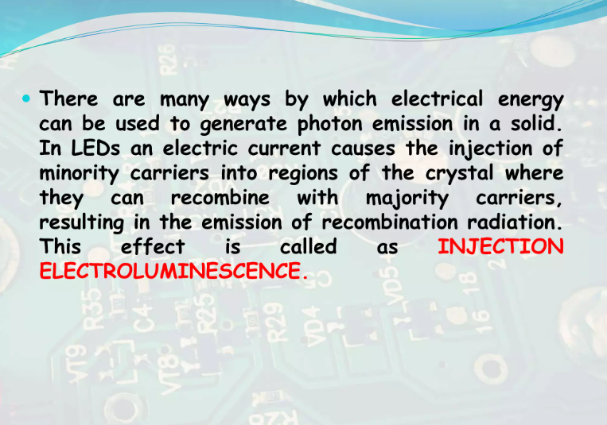

Slide 8


Slide 9
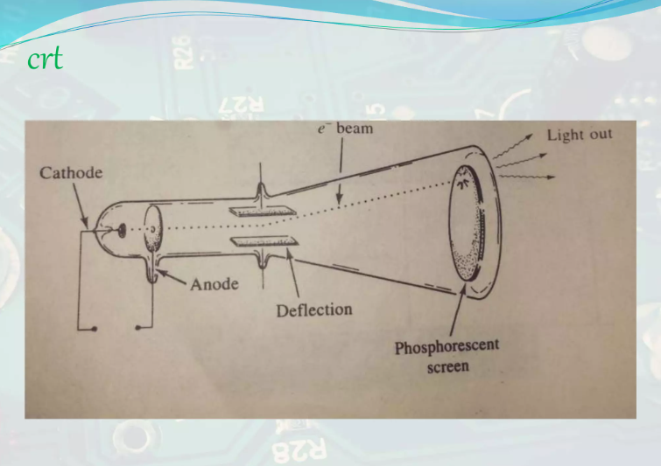

Slide 10
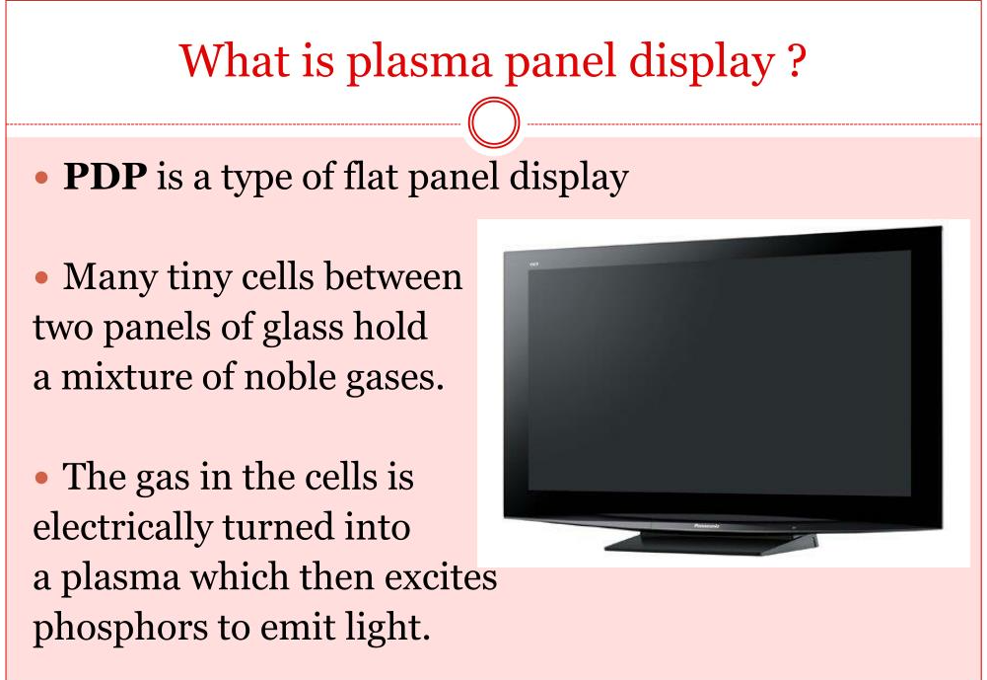

Slide 11


Slide 12
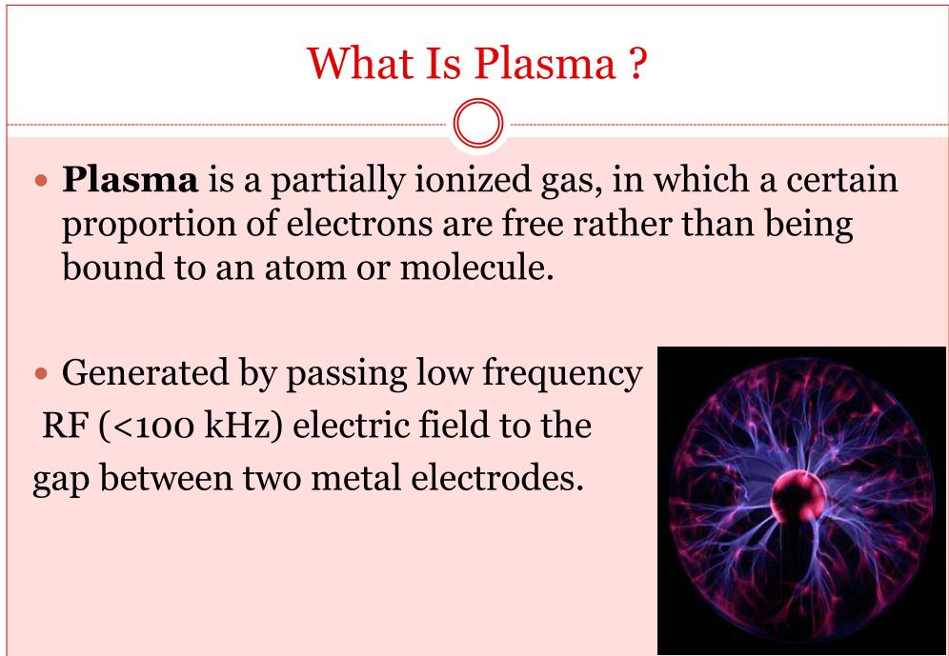

Slide 13
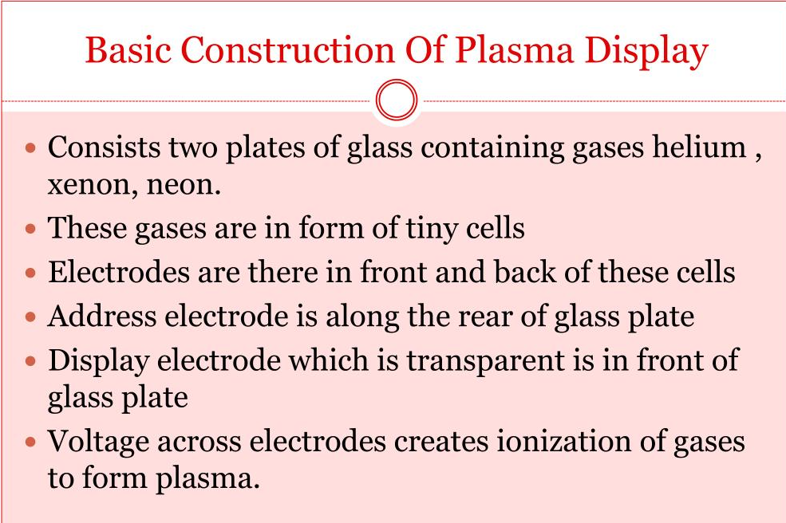

Slide 14
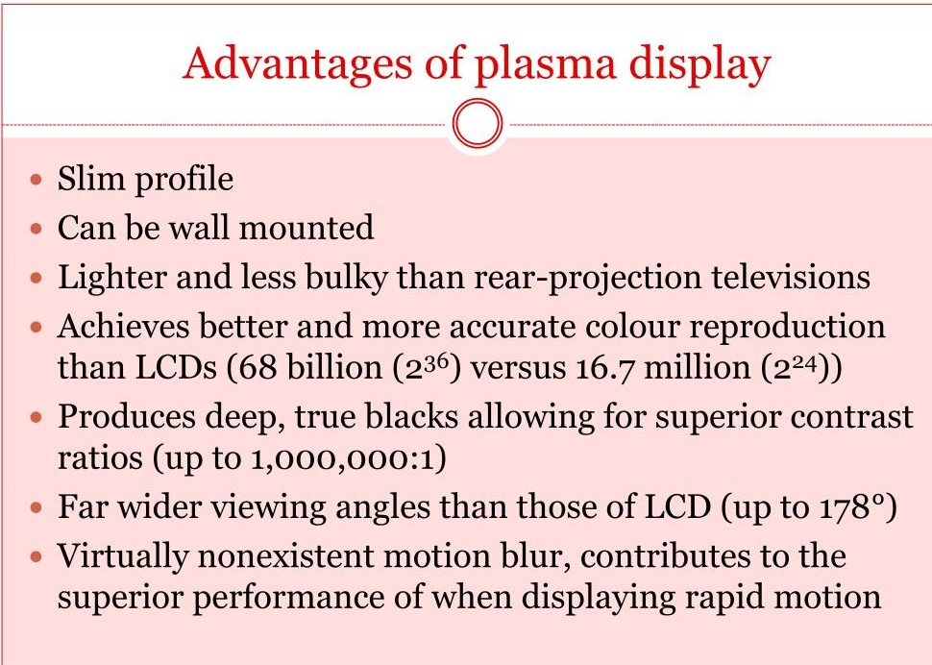

Slide 15
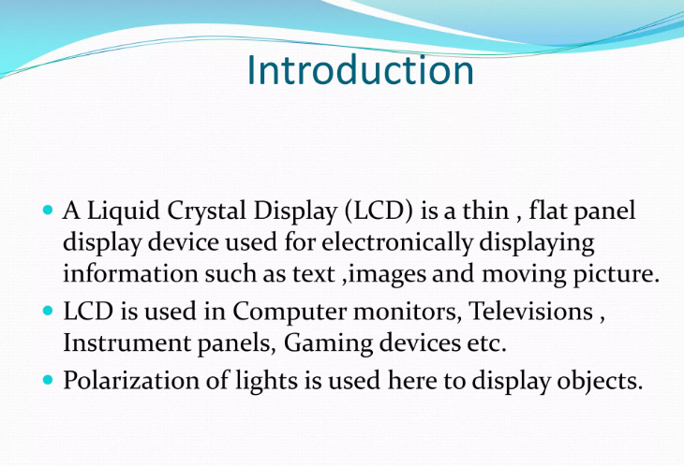

Slide 16
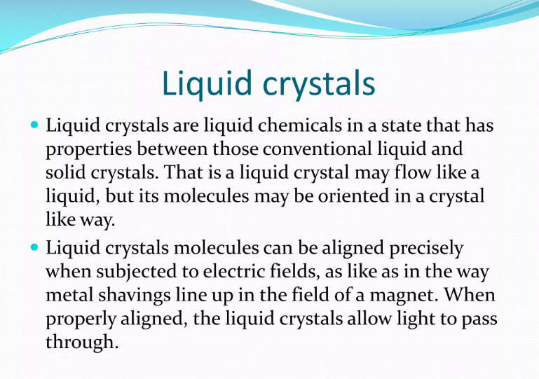

Slide 17
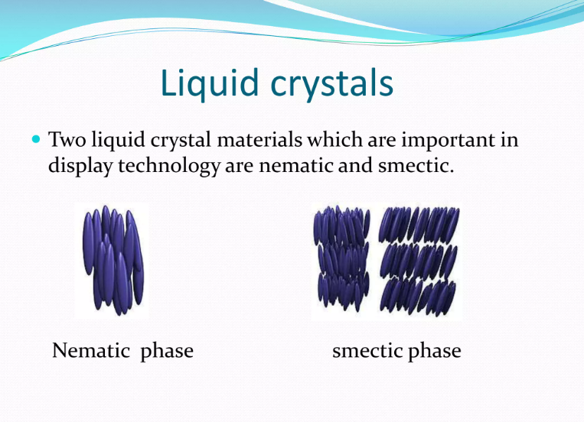

Slide 18
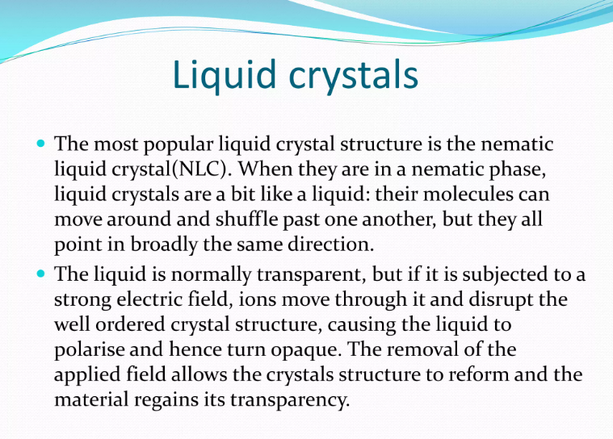

Slide 19
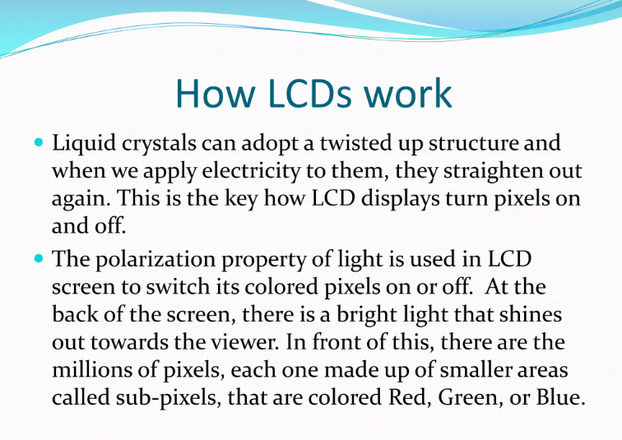

Slide 20
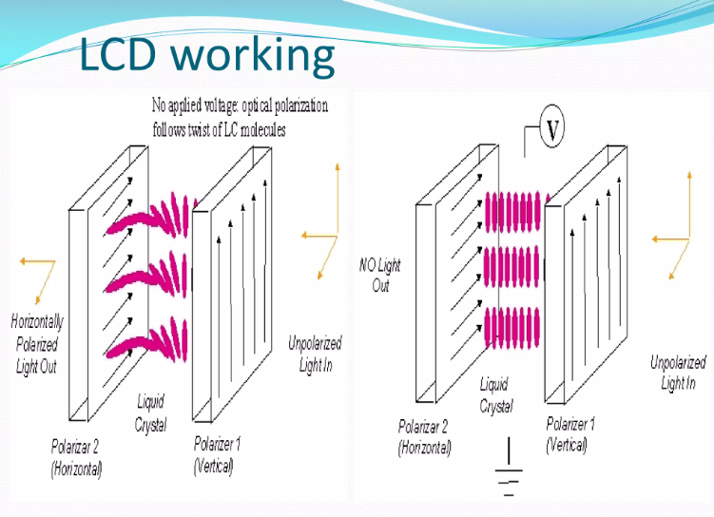

Slide 21
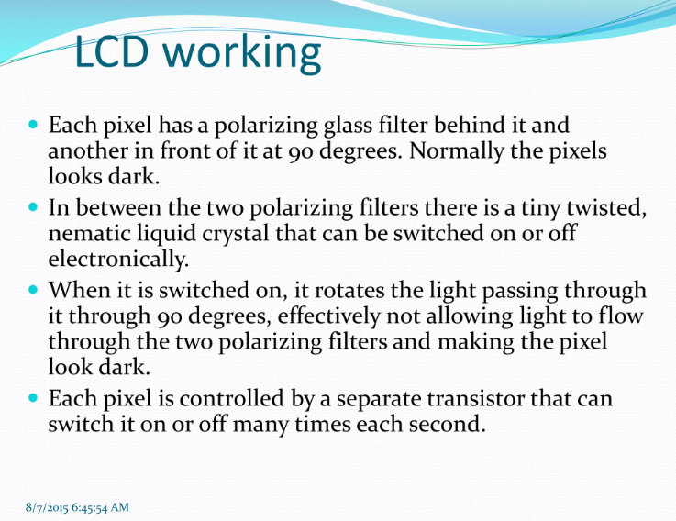

Slide 22
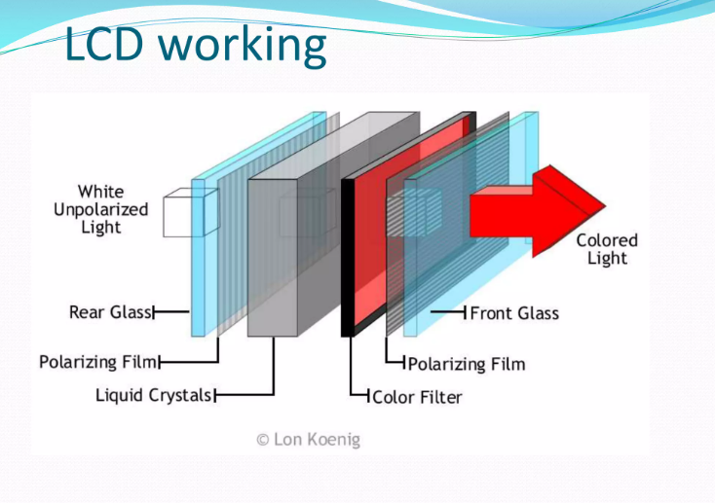

Slide 23
LED

Slide 24
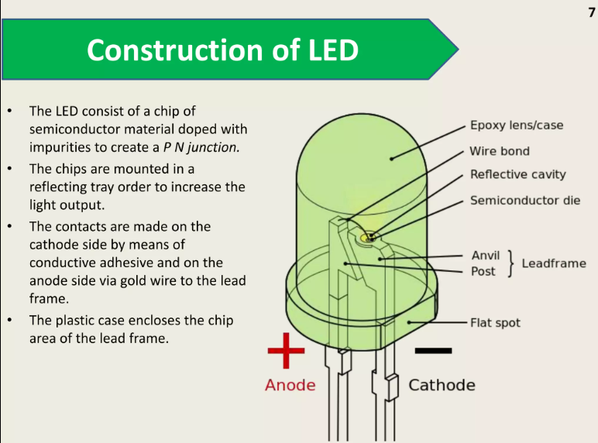

Slide 25
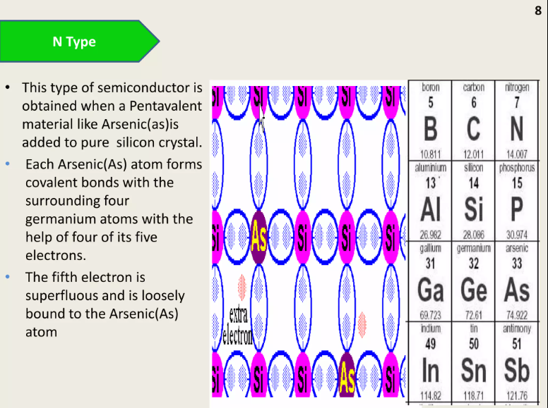

Slide 26
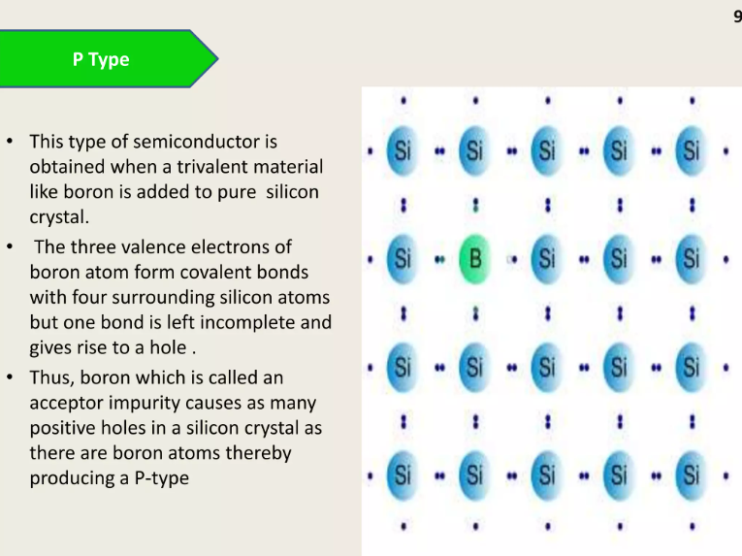

Slide 27
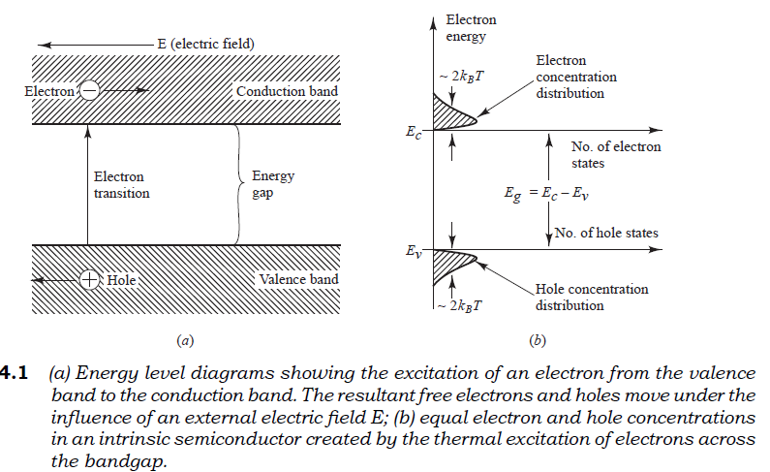

Slide 28


Slide 29
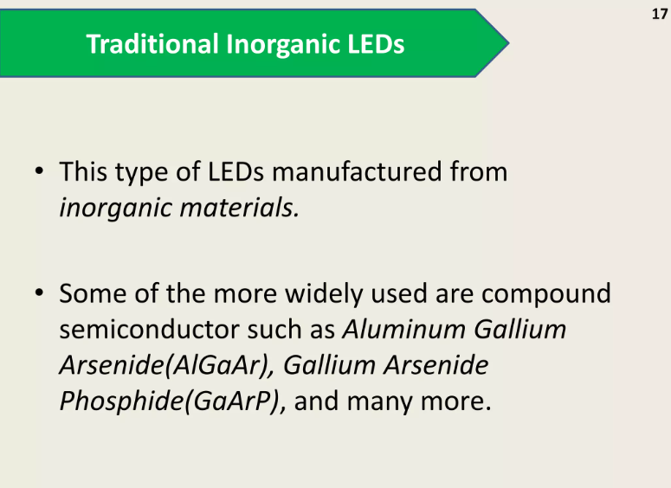

Slide 30
optical confinement
To achieve carrier and optical confinement, LED configurations such as homo junctions and single
and double heterojunctions have been widely investigated.
This is referred to as a double-hetero structure (or heterojunction) device because of the two different alloy layers on each side of the active region.
This configuration evolved by means of this sandwich structure of differently composed alloy layers, both the carriers and the optical field are confined in the central active layer. The bandgap differences of adjacent layers confine the charge carriers , while the differences in the indices of refraction of adjoining layers confine the optical field to the central active layer.
This dual confinement leads to both high efficiency and high radiance. Other parameters influencing the device performance include optical absorption in the active region (self-absorption), carrier recombination at the hetero structure interfaces, doping concentration of the active layer, injection carrier density, and active layer thickness.

Slide 31
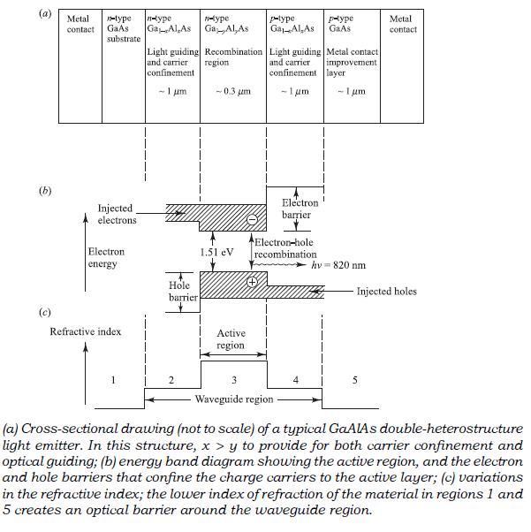
LED structure

Slide 32
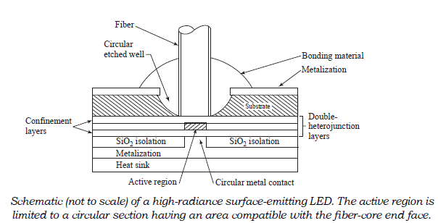
Surface emitter
In the surface emitter, the plane of the active light-emitting region is oriented perpendicularly to the axis of the fiber.
In this configuration, a well is etched through the substrate of the device, into which a fiber is then cemented in order to accept the emitted light.
The circular active area in practical surface emitters is nominally 50 mm in diameter and up to 2.5 mm thick. The emission pattern is essentially isotropic with a 120° half-power beam width.
This isotropic pattern from such a surface emitter is called a lambertian pattern. In this pattern, the source is equally bright when viewed from any direction, but the power diminishes as cos q, where q is the angle between the viewing direction and the normal to the surface (this is because the projected area one sees decreases as cos q).

Slide 33
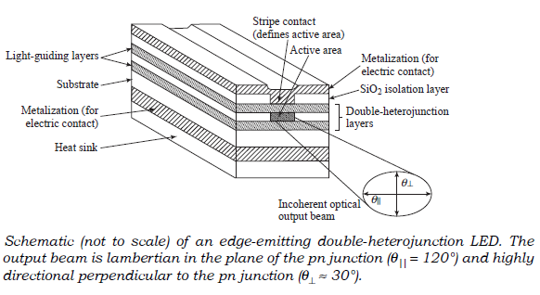
Edge emitter
The edge emitter depicted consists of an active junction region, which is the source of the incoherent light, and two guiding layers.
The guiding layers both have a refractive index lower than that of the active region but higher than the index of the surrounding material.
This structure forms a waveguide channel that directs the optical radiation toward the fiber core. To match the typical fiber-core diameters (50–100 mm), the contact stripes for the edge emitter are 50–70 mm wide.
Lengths of the active regions usually range from 100 to 150 mm. The emission pattern of the edge emitter is more directional than that of the surface emitter.
In the plane parallel to the junction, where there is no waveguide effect, the emitted beam is lambertian (varying as cos q) with a half-power width of q| | = 120°.
In the plane perpendicular to the junction, the half-power beam q^ has been made as small as 25–35° by a proper choice of the waveguide thickness.

Slide 34
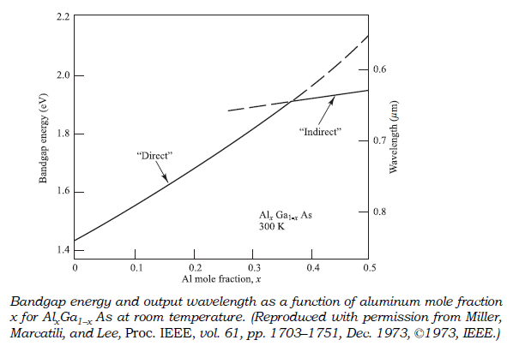
Material
The alloys GaAlAs and InGaAsP are chosen to make semiconductor light sources because it is possible to match the lattice parameters of the heterostructure interfaces by using a proper combination of binary, ternary, and quaternary materials.
For operation in the 800-to-900-nm spectrum, the principal material used is the ternary alloy Ga1–xAlxAs. The ratio x of aluminum arsenide to gallium arsenide determines the bandgap of the alloy and, correspondingly, the wavelength of the peak emitted radiation.
The value of x for the active-area material is usually chosen to give an emission wavelength of 800–850 nm. An example of the emission spectrum of a Ga1–xAlxAs LED with x = 0.08.
The peak output power occurs at 810 nm. The width of the spectral pattern at its half-power point is known as the full-width halfmaximum (FWHM) spectral width. this FWHM spectral width sl is 36 nm.

Slide 35
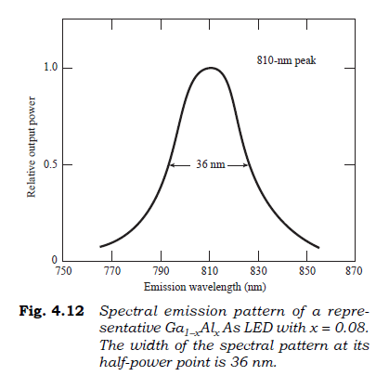
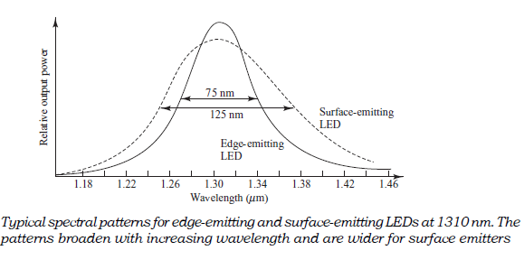

Slide 36
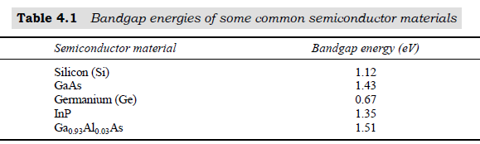
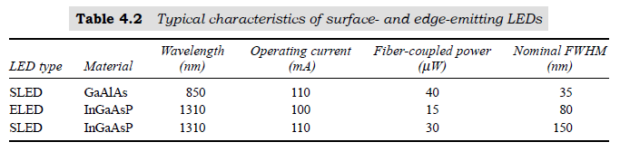
The materials used in these examples are GaAlAs for operation at 850 nm and InGaAsP for 1310-nm devices. The fiber-coupled power listing is the amount of light that can be accepted by a 50-mm core diameter multimode fiber.

Slide 37
Quantum Efficiency and LED Power

Slide 38
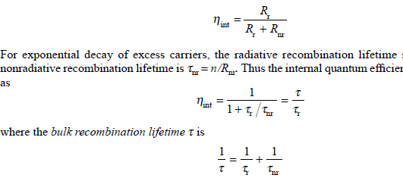
In radiative recombination a photon of energy hn, which is approximately equal to the bandgap energy, is emitted. Nonradiative recombination effects include optical absorption in the active region.
The internal quantum efficiency in the active region is the fraction of the electron–hole pairs that recombine radiatively. If the radiative recombination rate is Rr and the non radiative recombination rate is Rnr, then the internal quantum efficiency (eta_int) is the ratio of the radiative recombination rate to the total recombination rate:

Slide 39
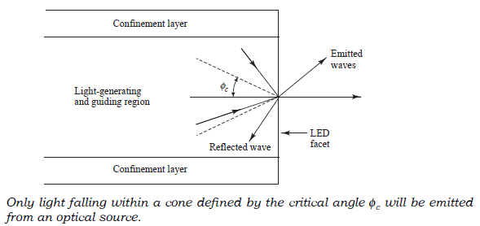
This also means that Rr and Rnr are similar in magnitude, so that the internal quantum efficiency is about 50 percent for simple homojunction LEDs.
However, LEDs having double-heterojunction structures can have quantum efficiencies of 60–80 percent.
This high efficiency is achieved because the thin active regions of these devices mitigate the self-absorption effects, which reduces the nonradiative recombination rate.

Slide 40
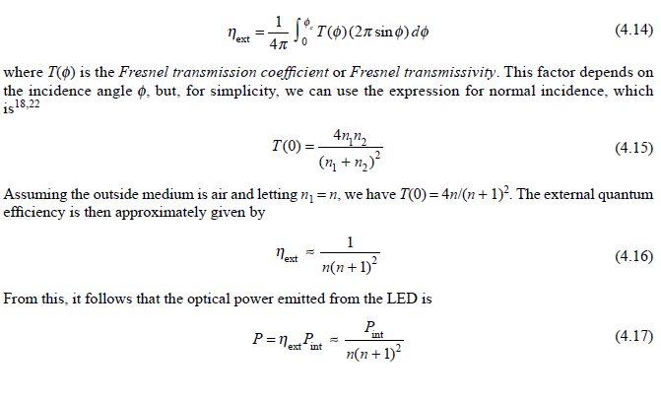
Not all internally generated photons will exit the device.
To find the emitted power, one needs to consider the external quantum efficiency hext. This is defined as the ratio of the photons emitted from the LED to the number of internally generated photons. To find the external quantum efficiency, we need to take into account reflection effects at the surface of the LED.

Slide 41
Laser

Slide 42
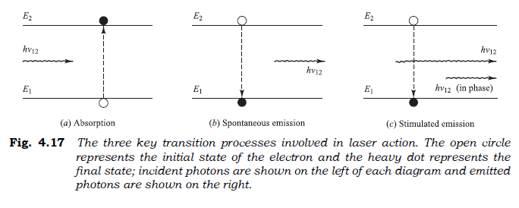
Laser action is the result of three key processes:
photon absorption,
spontaneous emission, and
stimulated emission.
if a photon of energy hn12 impinges on the system while the electron is still in its excited state, the electron is immediately stimulated to drop to the ground state and give off a photon of energy hn12. This emitted photon is in phase with the incident photon, and the resultant emission is known as stimulated emission.

Slide 43
population inversion
In thermal equilibrium the density of excited electrons is very small. Most photons incident on the system will therefore be absorbed, so that stimulated emission is essentially negligible. Stimulated emission will exceed absorption only if the population of the excited states is greater than that of the ground state. This condition is known as population inversion.
Since this is not an equilibrium condition, population inversion is achieved by various “pumping” techniques.
A basic requirement for efficient operation of laser diodes is that, in addition to transverse optical confinement and carrier confinement between heterojunction layers, the current flow must be restricted laterally to a narrow stripe along the length of the laser.

Slide 44
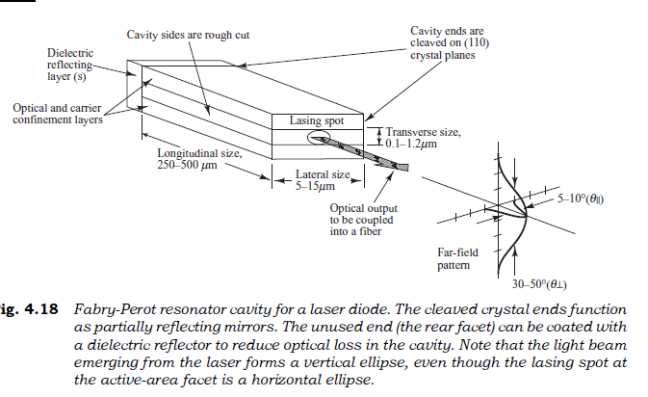
Fabry-Perot resonator
Stimulated emission in semiconductor lasers arises from optical transitions between distributions of energy states in the valence and conduction bands. This differs from gas and solid-state lasers, in which radiative transitions occur between discrete isolated atomic or molecular levels. The radiation in one type of laser diode configuration is generated within a Fabry-Perot resonator cavity.

Slide 45
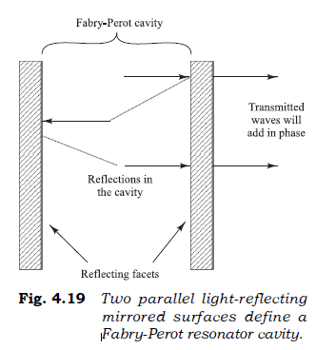
The purpose of the mirrors is to establish a strong optical feedback in the longitudinal direction. This feedback mechanism converts the device into an oscillator (and hence a light emitter) with a gain mechanism that compensates for optical losses in the cavity at certain resonant optical frequencies.
As the light reflects back and forth within the Fabry-Perot cavity, the electric fields of the light interfere on successive round trips. Those wavelengths that are integer multiples of the cavity length interfere constructively so that their amplitudes add when they exit the device through the righthand facet. All other wavelengths interfere destructively and thus cancel themselves out. The optical frequencies at which constructive interference occurs are the resonant frequencies of the cavity.

Slide 46
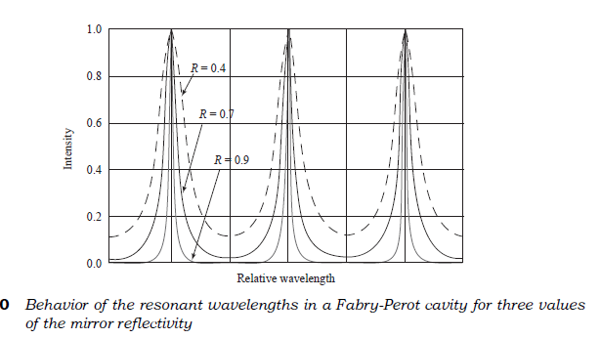
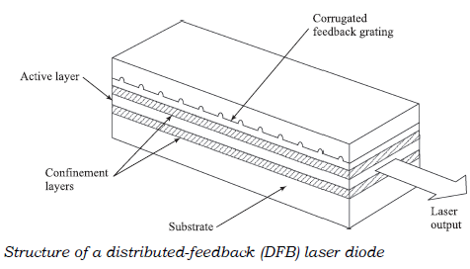
The width of the resonances depends on the value of the reflectivity. That is, the resonances become sharper as the reflectivity increases.
As the distributed-feedback (DFB) laser, the cleaved facets are not required for optical feedback.

Slide 47
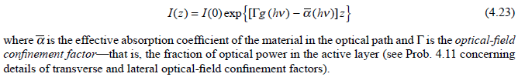
Lasing is the condition at which light amplification becomes possible in the laser diode. The requirement for lasing is that a population inversion be achieved. This condition can be understood by considering the fundamental relationship between the optical field intensity I, the absorption coefficient al , and the gain coefficient g in the Fabry-Perot cavity.
Lasing occurs when the gain of one or several guided modes is sufficient to exceed the optical loss during one roundtrip through the cavity; that is, z = 2L.

Slide 48
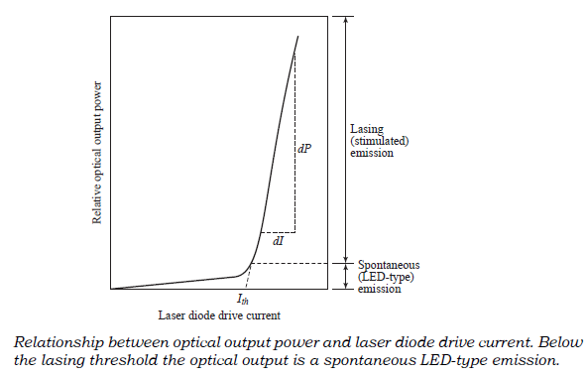
At low diode currents, only spontaneous radiation is emitted. Both the spectral range and the lateral beam width of this emission are broad like that of an LED.
A dramatic and sharply defined increase in the power output occurs at the lasing threshold. As this transition point is approached, the spectral range and the beam width both narrow with increasing drive current. The final spectral width of approximately 1 nm and the fully narrowed lateral beam width of nominally 5–10° are reached just past the threshold point.
The threshold current Ith is conventionally defined by extrapolation of the lasing region of the power-versus-current curve.

Slide 49
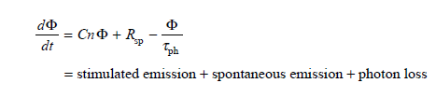
The relationship between optical output power and the diode drive current can be determined by examining the rate equations that govern the interaction of photons and electrons in the active region.
As noted earlier, the total carrier population is determined by carrier injection, spontaneous recombination, and stimulated emission.
For a pn junction with a carrier-confinement region of depth d, the rate equations are given by

Slide 50
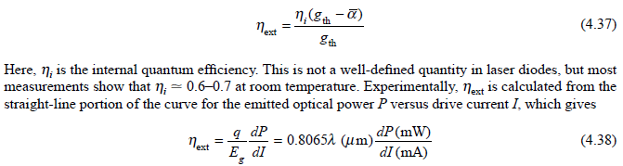
The external differential quantum efficiency hext is defined as the number of photons emitted per radiative electron–hole pair recombination above threshold.
Under the assumption that above threshold the gain coefficient remains fixed at gth, hext is given by

Slide 51
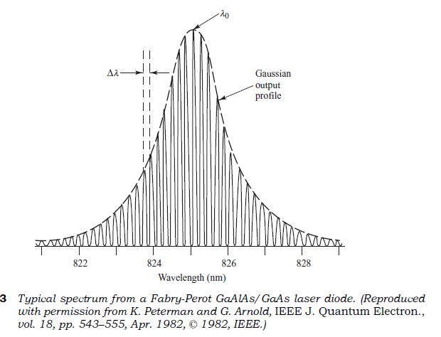
In the first structure, a narrow electrode stripe (less than 8 mm wide) runs along the length of the diode. The injection of electrons and holes into the device alters the refractive index of the active layer directly below the stripe. The profile of these injected carriers creates a weak, complex waveguide that confines the light laterally.
This type of device is commonly referred to as a gain-guided laser.

Slide 52
Single-Mode Lasers

Slide 53
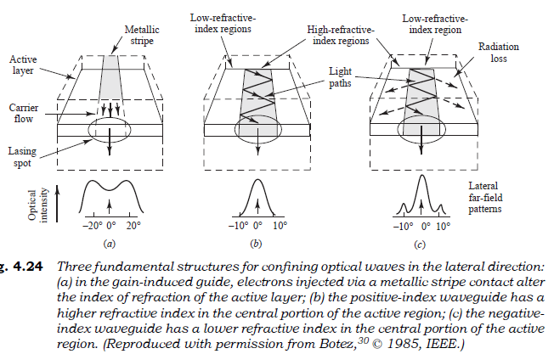
single-mode laser.
More stable structures use the configurations shown in Fig.
Here, dielectric waveguide structures are fabricated in the lateral direction. The variations in the real refractive index of the various materials in these structures control the lateral modes in the laser. Thus, these devices are called index-guided lasers. If a particular index-guided laser supports only the fundamental transverse mode and the fundamental longitudinal mode, it is known as a single-mode laser.

Slide 54
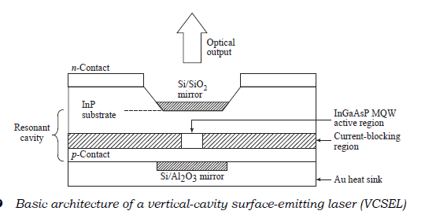
VCSEL
For high-speed long-distance communications one needs single-mode lasers, which must contain only a single longitudinal mode and a single transverse mode. Consequently, the spectral width of the optical emission is very narrow.
Ex.
For a Fabry-Perot cavity, all longitudinal modes have nearly equal losses and are spaced by about 1 nm in a 250-mm-long cavity at 1300 nm. By reducing L from 250 mm to 25 mm, the mode spacing increases from 1 nm to 10 nm.
The special feature of a vertical-cavity surface-emitting laser (VCSEL) is that the light emission is perpendicular to the semiconductor surface. This feature facilitates the integration of multiple lasers onto a single chip in one- or two-dimensional arrays, which makes them attractive for wavelength-division-multiplexing applications. The active-region volume of these devices is very small, which leads to very low threshold currents (< 100 mA).

Slide 55
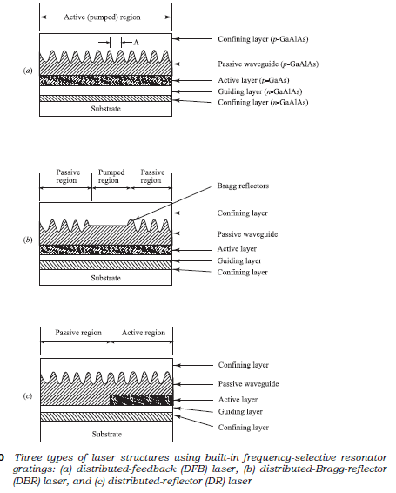
Three types of laser configurations using a built-in frequency-selective reflector.
In each case, the frequency-selective reflector is a corrugated grating that is a passive waveguide layer adjacent to the active region.
The optical wave propagates parallel to this grating. The operation of these types of lasers is based on the distributed Bragg phase-grating reflector.
A phase grating is essentially a region of periodically varying refractive index that causes two counter propagating traveling waves to couple.

Slide 56
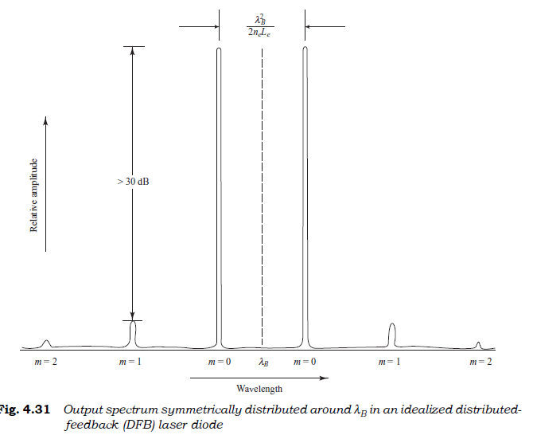
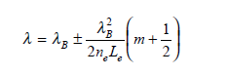
In the distributed-feedback (DFB) laser, the grating for the wavelength selector is formed over the entire active region.
where m = 0, 1, 2, ... is the mode order and Le is the effective grating length. The amplitudes of successively higher-order lasing modes are greatly reduced from the zero-order amplitude;

Slide 57
Introduction to Fiber Amplifiers

Slide 58
To amplify an optical signal with a conventional repeater, one performs photon-to-electron conversion, electrical amplification, retiming, pulse shaping, and then electron-to-photon conversion. Although this process works well for moderate-speed single-wavelength operation, it can present a data transmission bottleneck for high-speed multiple-wavelength systems.
Thus to eliminate the transmission delay problem a great deal of effort has been expended to develop all-optical amplifiers. These devices operate completely in the optical domain to boost the power levels of multiple light wave signals over spectral bands of 30 nm and more.
Semiconductor optical amplifiers (SOAs)
Erbium-doped fiber amplifiers (EDFAs)

Slide 59
Optical amplifiers have found widespread use in diverse applications ranging from ultra-long undersea links to short links in access networks.
In long-distance undersea and terrestrial point-to-point links, the traffic patterns are relatively stable, so that the input power levels to an optical amplifier do not vary significantly.
However, since many closely spaced wavelength channels are being transported over these links, the amplifier must have a wide spectral response range and be highly reliable.

Slide 60
Semiconductor Optical Amplifiers

Slide 61
A semiconductor optical amplifier is essentially an InGaAsP laser that is operating below its threshold point.
Analogous to the construction of a laser diode, the gain peak of an SOA can be selected in any narrow wavelength band extending from 1280 nm in the O-band to 1650 nm in the U-band by varying the composition of the active InGaAsP material.

Slide 62
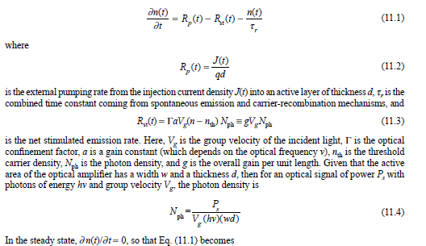
The SOA construction is similar to a resonator cavity structure of a laser diode. The SOA has an active region of length L, width w, and height d. The end facets have reflectivities R1 and R2.

Slide 63

Amplifier Gain
One of the most important parameters of an optical amplifier is the signal gain or amplifier gain G, which is defined as

Slide 64

Here, the zero-signal gain (or small-signal gain) is G0 = 30 dB, which is a gain factor of 1000. The curve shows that as the input signal power is increased, the gain first stays near the small-signal level and then starts to decrease.
After decreasing linearly in the gain saturation region, it finally approaches an asymptotic value of 0 dB (a unity gain) for high input powers.

Slide 65


where G is the single-pass gain, R1 and R2 are the input and output facet reflectivities, respectively, and j is the single-pass phase shift through the amplifier.

Slide 66
Erbium-Doped Fiber Amplifiers
The active medium in an optical fiber amplifier consists of a nominally 10- to 30-m length of optical fiber that has been lightly doped (e.g., 1000 parts per million weight) with a rare-earth element, such as erbium (Er), ytterbium(Yb), thulium (Tm), or praseodymium (Pr). The host fiber material can be standard silica, a fluoride-based glass, or a tellurite glass.
The operating regions of these devices depend on the host material and the doping elements. A popular material for long-haul telecommunication applications is a silica fiber doped with erbium, which is known as an erbium-doped fiber amplifier or EDFA. In some cases Yb is added to increase the pumping efficiency and the amplifier gain. The operation of a standard EDFA normally is limited to the 1530 to l565 nm region.

Slide 67

Amplification Mechanism
Whereas semiconductor optical amplifiers use external current injection to excite electrons to higher energy levels, optical fiber amplifiers use optical pumping.
The optical pumping process requires three or more energy levels. The top energy level to which the electron is elevated initially must lie energetically above the desired final emission level. After reaching its initial excited state, the electron must quickly release some of its energy and drop to a slightly lower energy level.
A signal photon can then trigger the excited electron sitting in this new lower level into stimulated emission, whereby the electron releases its remaining energy in the form of a new photon with a wavelength identical to that of the signal photon.

Slide 68

The absorption and emission responses of an EDFA depend on the composition of the host glass and on the types of dopants, such as Ge and Al, in the glass.
For a Ge-doped silica glass that has Al codopants added, the Al atoms help to absorb the Er ions in the glass, and they broaden the amplifier gain spectrum. Note that there is a peak gain response at 1532 nm and a 20- to 30-nm region at longer wavelengths in which the gain is relatively flat. Beyond 1560 nm the gain decreases steadily until it reaches 0 dB (unity gain) at around 1616 nm.

Slide 69

An optical fiber amplifier consists of a doped fiber, one or more pump lasers, a passive wavelength coupler, optical isolators, and tap couplers. The dichroic (two-wavelength) coupler handles either 980/1550-nm or 1480/1550-nm wavelength combinations to couple both the pump and signal optical powers efficiently into the fiber amplifier.

Slide 70

The onset of gain saturation for various doped-fiber lengths as the pumping power increases. The gain was measured for a 100-nW input signal at 1550 nm.
As the fiber length increases for low pumping powers, the gain starts to decrease after a certain length because the pump does not have enough energy to create a complete population inversion in the downstream portion of the amplifier.
In this case, the unpumped region of the fiber absorbs the signal, thus resulting in signal loss rather than gain in that section.

Slide 71
How will give information/message into light/photon?

Slide 72
Modulation of Laser Diodes

Slide 73
The process of putting information onto a lightwave is called modulation. For data rates of less than approximately 10 Gb/s (typically 2.5 Gb/s), the process of imposing information on a laser-emitted light stream can be realized by direct modulation.
This involves directly varying the laser drive current with the electrically formatted information stream to produce a correspondingly varying optical output power.
For higher data rates one needs to use a device called an external modulator to temporally modify a steady optical power level emitted by the laser.
Basic limitation on the direct modulation rate of laser diodes depends on the spontaneous and stimulated emission carrier lifetimes and on the photon lifetime.
The spontaneous carrier lifetime tsp is a function of the semiconductor band structure and the carrier concentration. At room temperature this lifetime is about 1 ns in GaAs-based materials for dopant concentrations on the order of 1019 cm–3.

Slide 74

The stimulated carrier lifetime tst depends on the optical density in the lasing cavity and is on the order of 10 ps. The photon lifetime tph is the average time that the photon resides in the lasing cavity before being lost either by absorption or by emission through the facets. In a Fabry-Perot cavity, the photon lifetime is

Slide 75

A laser diode can readily be pulse-modulated because the photon lifetime is much smaller than the carrier lifetime. If the laser is completely turned off after each pulse, the spontaneous carrier lifetime
will limit the modulation rate. This is because, at the onset of a current pulse of amplitude Ip, a period of time td given by

Slide 76



Slide 77

External modulator
When direct modulation is used in a laser transmitter, the process of turning the laser on and off with an
electrical drive current produces a widening of the laser linewidth. This phenomenon is referred to as chirp
and makes directly modulated lasers undesirable for operation at data rates greater than about 2.5 Gb/s.
For these higher-rate applications it is preferable to use an external modulator. In such a configuration, the optical source emits a constant-amplitude light signal, which enters the external modulator. In this case, instead of varying the amplitude of the light coming out of the laser, the electrical driving signal dynamically changes the optical power level that exits the external modulator. This process thus produces a time-varying optical signal

Slide 78

Mach-Zehnder Modulator
The electro-optical (EO) phase modulator (also called a Mach-Zehnder Modulator or MZM) typically is made of lithium niobate (LbNiO3). In an EO modulator the light beam is split in half and then sent through two separate paths. A high-speed electric signal then changes the phase of the light signal in one of the paths. This is done in such a manner that when the two halves of the signal meet again at the device output, they will recombine either constructively or destructively.

Slide 79
Transmitter Packages

Slide 80

Manufacturers have developed a variety of transmitter packages for different applications. One popular transmitter configuration is shown in Fig. This is called a butterfly package, which has an attached fiber flylead and contains the components (such as the diode laser, a monitoring photodiode, and a thermoelectric cooler).

Slide 81


Slide 82


